Slide 1




FRONT-END DEVELOPMENT
ASSIGNMENT 2 TEMPLATE
STUDENT NAME: Hariharan S
YEAR: II
COLLEGE CODE: 1455
COLLEGE NAME: Tagore College of Arts and Science .
DEPARTMENT: Computer Science
SEMESTER: IV
ROLL NO: unm1455222407723
NMID: 614D89761591EB584744FC4BCEE6FE5F
DATE: 10/03/2026
PROJECT TITLE: CSS Styling for Event Registration
1. Problem Statement:
The goal is to improve the simple registration page I built in Assignment-1. While the structure was there, it didn't look like a real website. This update uses CSS to fix the layout, add professional spacing, and make it easier for students to read the event details and fill out the form without it feeling cluttered.
2. Objective:
(My main objective is to move from "plain HTML" to a "Styled UI." I want to learn how to use the CSS Box Model (padding, margins, borders) to control where things sit on the page and use colors to make the form look like a modern card-style interface.
Requirements:
Visual Design: Transform the HTML structure into a professional-looking interface
Layout Management: Use the Box Model to center the form and space out elements.
Interactive Elements: Add hover effects and real-time input validation.
Data Readability: Style tables and footers for a clean, organized presentation.
3.1 Apply Global Styling:
Background: Applied a light blue background color (#f0f8ff) to the entire page.
Typography: Set the primary font family to Arial, sans-serif for clean readability.
Spacing: Used padding: 20px and margin: 0 on the body to ensure content is well-spaced.

Slide 2
3.2 Style the Event Title and Description:
Prominence: Centered the h2 heading and increased its visibility.
Readability: Maintained a clear registration instruction paragraph below the title
3.3. Design the Event Information Section
Alignment: Centered the information table using margin: 20px auto.
Table Structure: Applied border-collapse: collapse and added padding to the event data cells.
3.4 Enhance the Registration Form Layout:
Card Layout: Placed the form in a centered container with a white background and 10px rounded corners.
Visual Depth: Added a light box-shadow to make the form stand out from the background.
3.5 Style Fieldsets and Legends:
Structure: Applied light gray borders (#ddd) and internal padding to all fieldsets.
Text Styling: Set the legends to bold to clearly identify each form section.
3.6 Improve Input Elements:
Consistency: Removed default input lines and ensured inputs have uniform width within the form.
Validation: Coded the borders to change to green for correct input and red for errors.
3.7 Button Styling:
Visual Design: Styled the "Submit" button with a dark blue background and "Reset" with a red background.
Interactivity: Added cursor: pointer and rounded edges for a modern feel.

Slide 3
3.8 Style the Participants Table:
Header Style: Highlighted the table headers <th> with a bright yellow background (#ffeb3b).
Readability: Applied consistent borders and padding to ensure student data is easy to scan
3.9 Style the Declaration Section:
Alignment: Ensured the "I confirm" checkbox is properly aligned with the label text.
Spacing: Added a bottom margin to separate the checkbox from the action buttons.
3.10 Footer Design:
Separation: Added a large top margin (50px) to clearly separate contact info from the form.
Subtlety: Reduced the font size to 0.9em and used a different text color (#555) for a professional finish.
4.CSS Concepts Used:
To transform the page, I utilized the following core CSS principles:
Selectors: Used element (body, form), ID (#regForm, #pTable), and class (.info) selectors to apply specific styles.
Box Model: Managed margin, border, and padding to control the spacing and size of every element.
Typography: Applied font-family (Arial) and text-align to ensure a professional and readable look.
Visual Effects: Implemented border-radius for rounded corners and box-shadow to give the form depth.
Interactive States: Used pseudo-classes like :hover for buttons and :valid / :invalid for real-time input validation.
5. Implementation Steps:
File Creation: Created an external style.css and linked it to index.html using the <link> tag in the head section.
Global Reset: Defined the body background color as #f0f8ff and set a consistent font style.
Form Structuring: Wrapped the registration fields in a card-style layout with a white background and centered it on the page.
Field & Label Tuning: Adjusted input widths and added padding to make text entry comfortable for the user.
Validation Logic: Added CSS rules to change input borders to Green for correct data and Red for errors.
Table & Footer Polish: Styled the participants table with a yellow header and defined a separate background for the contact footer.

Slide 4
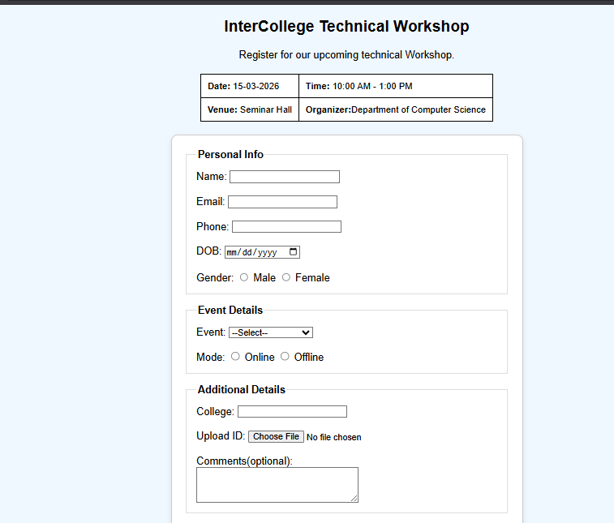
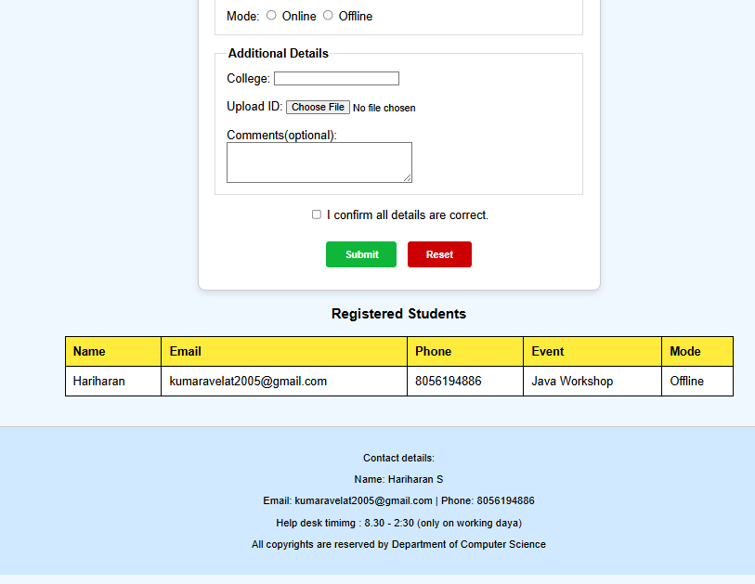
6.Output:

Slide 5
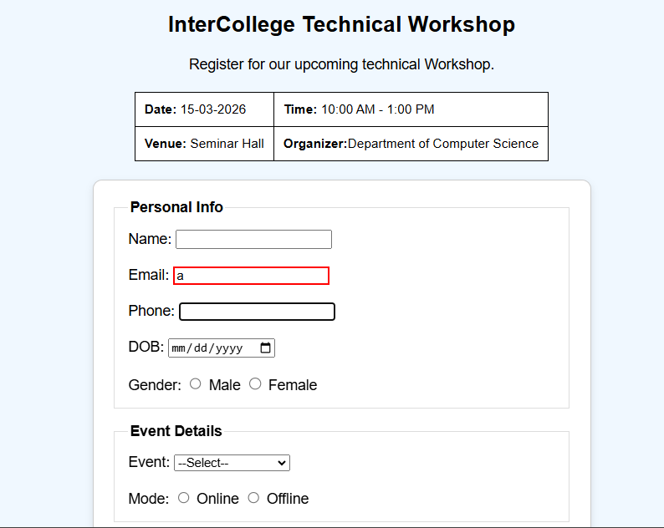
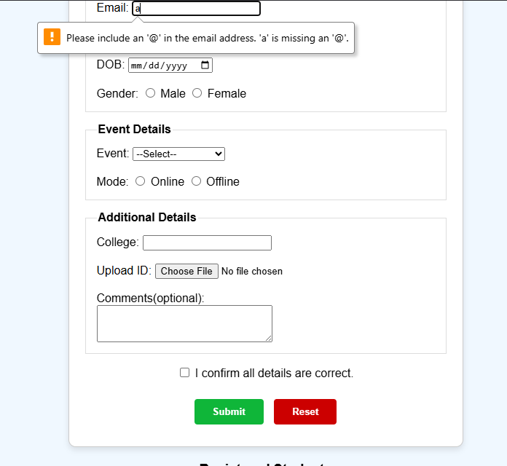
7.Learning Outcome:
Layout Mastery: I learned how to use the CSS Box Model to turn a vertical list of HTML tags into a balanced, centered interface.
Visual Design: I understood how small details like border-radius and box-shadow can make a website look modern rather than basic.
User Feedback: I discovered how to use CSS validation to provide instant visual feedback to users without needing complex scripts.
Organization: I learned the importance of using an external stylesheet (style.css) to keep my project code clean and manageable.
8. Conclusion:
The project successfully meets all requirements for Assignment-2. By applying CSS, I have transformed a plain HTML structure into a clean, professional-looking event registration portal. The final result is visually appealing, easy to navigate, and demonstrates a solid understanding of presentation-layer design.

